Slide 1

Design Patterns
SoftUni Team
Technical Trainers
Software University
https://softuni.bg

Slide 2
Table of Contents
Definition of Design Patterns
Benefits and Drawbacks
Types of Design Patterns
Creational
Structural
Behavioral

Slide 3
Have a Question?
sli.do
#csharp-advanced

Slide 4

Definition, Solutions and Elements
Design Patterns

Slide 5
What Are Design Patterns?
General and reusable solutions to common problems in software design
A template for solving given problems
Add additional layers of abstraction in order to reach flexibility
5

Slide 6
What Do Design Patterns Solve?
Patterns solve software structural problems like:
Abstraction
Encapsulation
Separation of concerns
Coupling and cohesion
Separation of interface and implementation
6

Slide 7
Elements of a Design Pattern
Pattern name - Increases vocabulary of designers
Problem - Intent, context and when to apply
Solution - Abstract code
Consequences - Results and trade-offs
7

Slide 8

Benefits and Drawbacks
Why Design Patterns?

Slide 9
Benefits
Names form a common vocabulary
Enable large-scale reuse of software architectures
Help improve developer communication
Can speed-up the development
9

Slide 10
Drawbacks
Do not lead to a direct code reuse
Deceptively simple
Developers may suffer from pattern overload and overdesign
Validated by experience and discussion, not by automated testing
Should be used only if understood well
10

Slide 11



Types of Design Patterns

Slide 12
Main Types
Creational patterns
Deal with initialization and configuration of classes and objects
Structural patterns
Describe ways to assemble objects to implement new functionality
Composition of classes and objects
Behavioral patterns
Deal with dynamic interactions among societies of classes
Distribute responsibility
12

Slide 13

Creational Patterns

Slide 14
Purposes
Deal with object creation mechanisms
Trying to create objects in a manner suitable to the situation
Two main ideas
Encapsulating knowledge about which classes the system uses
Hiding how instances of these classes are created
14

Slide 15
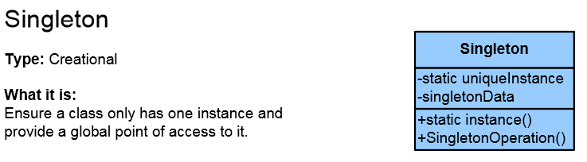
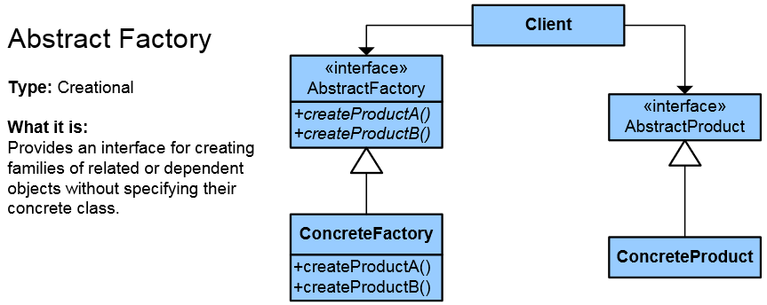
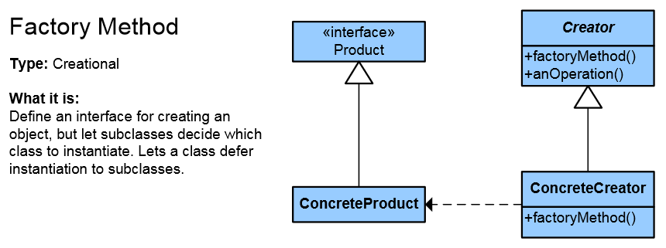
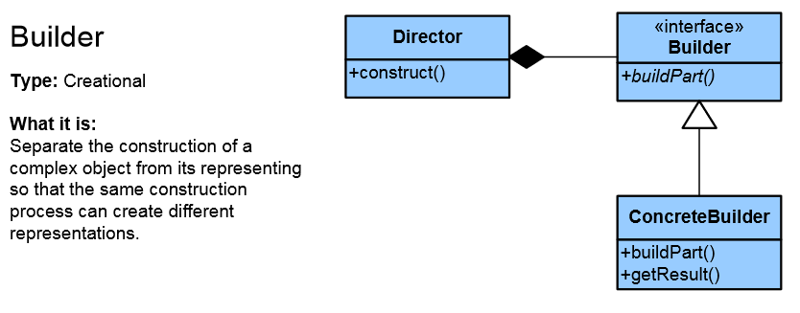
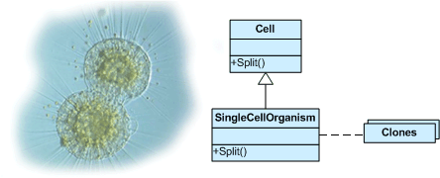
List of Creational Patterns
Singleton
Simple Factory
Factory Method
Abstract Factory
Builder
Prototype
Fluent Interface
Object Pool
Lazy Initialization

Slide 16
Singleton Pattern
The most often used creational design pattern
A Singleton class is supposed to have only one instance
It is not a global variable
Possible problems
Lazy loading
Thread-safe

Slide 17
Double-Check Singleton Example
public sealed class Singleton {
private static Singleton instance;
private static readonly object padlock = new object();
private Singleton() { }
public static Singleton Instance {
get {
if (instance == null) {
lock (padlock) {
if (instance == null)
instance = new Singleton(); } }
return instance; } } }
17

Slide 18
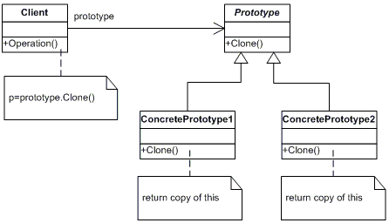
Prototype Pattern
Factory for cloning new instances from a prototype
Create new objects by copying this prototype
Instead if using the "new" keyword
ICloneable interface acts as Prototype

Slide 19
The Prototype Abstract Class
abstract class Prototype {
private string _id;
public Prototype(string id) {
this._id = id; }
public string Id => this._id;
public abstract Prototype Clone();
}
19

Slide 20
A Concrete Prototype Class
class ConcretePrototype : Prototype
{
public ConcretePrototype(string id) : base(id) { }
public override Prototype Clone()
=> return (Prototype)this.MemberwiseClone();
}
20

Slide 21

Structural Patterns

Slide 22
Purposes
Describe ways to assemble objects to implement a new functionality
Ease the design by identifying a simple way to realize relationship between entities
All about Class and Object composition
Inheritance to compose interfaces
Ways to compose objects to obtain new functionality
22

Slide 23
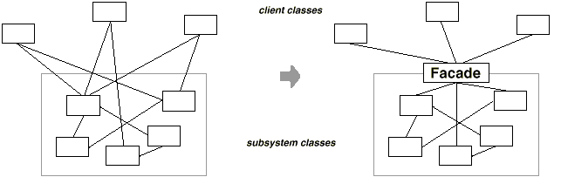
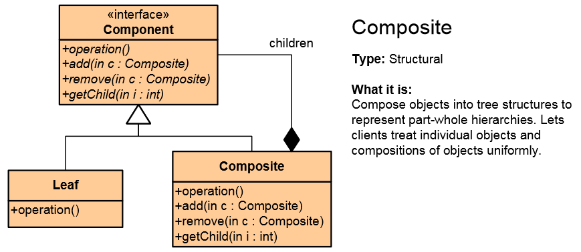
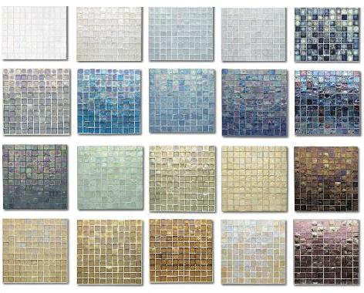
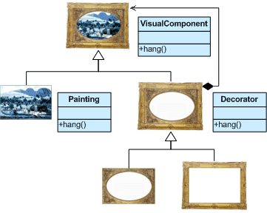
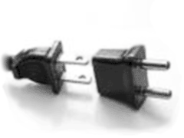
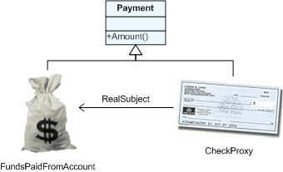
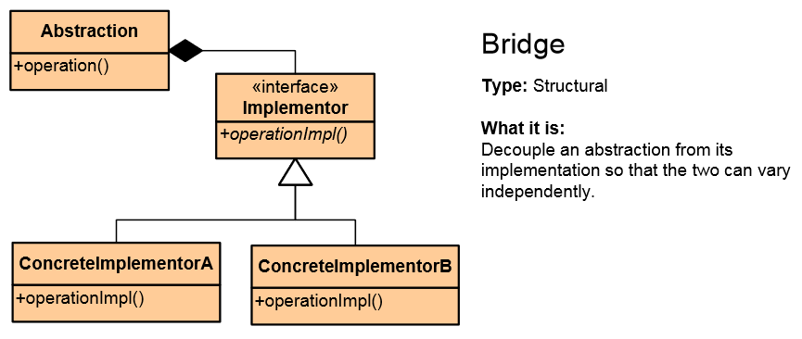
List of Structural Patterns
Façade
Composite
Flyweight
Proxy
Decorator
Adapter
Bridge

Slide 24
Façade Pattern
Provides a unified interface to a set of interfaces in a subsystem
Defines a higher-level interface that makes the subsystem easier to use

Slide 25
The Façade Class (1)
class Facade
{
private SubSystemOne _one;
private SubSystemTwo _two;
public Facade()
{
_one = new SubSystemOne();
_two = new SubSystemTwo();
}
25

Slide 26
The Façade Class (2)
public void MethodA() {
Console.WriteLine("\nMethodA() ---- ");
_one.MethodOne();
_two.MethodTwo(); }
public void MethodB() {
Console.WriteLine("\nMethodB() ---- ");
_two.MethodTwo(); }
}
26

Slide 27
Subsystem Classes
class SubSystemOne
{
public void MethodOne()
=> Console.WriteLine(" SubSystemOne Method");
}
class SubSystemTwo
{
public void MethodTwo()
=> Console.WriteLine(" SubSystemTwo Method");
}
27

Slide 28
Composite Pattern
Allows to combine different types of objects in tree structures
Gives the possibility to treat the same object(s)
Used when
You have different objects that you want to treat the same way
You want to present hierarchy of objects

Slide 29
The Component Abstract Class
abstract class Component {
protected string name;
public Component(string name) {
this.name = name; }
public abstract void Add(Component c);
public abstract void Remove(Component c);
public abstract void Display(int depth);
}
29

Slide 30
The Composite Class (1)
class Composite : Component {
private List<Component> _children = new List<Component>();
public Composite(string name) : base(name) { }
public override void Add(Component component)
=> _children.Add(component);
public override void Remove(Component component)
=> _children.Remove(component);
30

Slide 31
The Composite Class (2)
public override void Display(int depth)
{
Console.WriteLine(new String('-', depth) + name);
foreach (Component component in _children)
{
component.Display(depth + 2);
}
}
}
31

Slide 32
The Leaf Class
class Leaf : Component {
public Leaf(string name) : base(name) { }
public override void Add(Component c)
=> Console.WriteLine("Cannot add to a leaf");
public override void Remove(Component c)
=> Console.WriteLine("Cannot remove from a leaf");
public override void Display(int depth)
=> Console.WriteLine(new String('-', depth) + name);
}
32

Slide 33

Behavioral Patterns

Slide 34
Purposes
Concerned with interaction between objects
Either with the assignment of responsibilities between objects
Or encapsulating behavior in an object and delegating requests to it
Increases flexibility in carrying out cross-classes communication
34

Slide 35

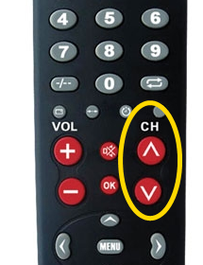
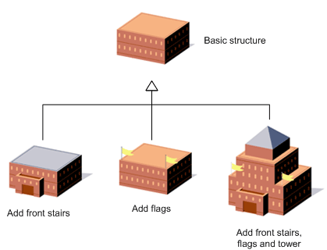
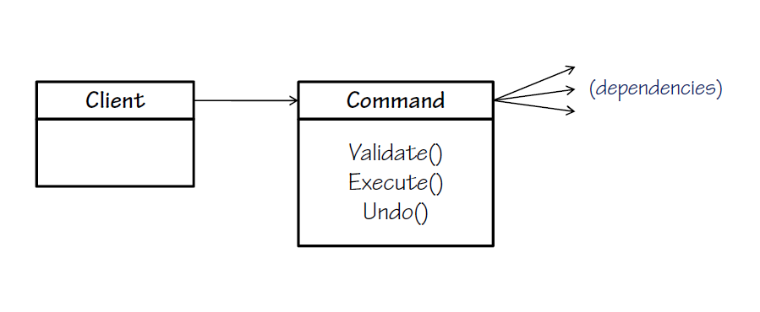
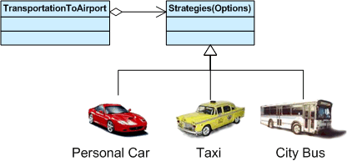
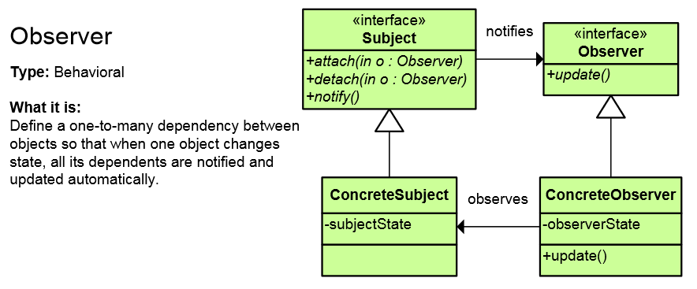
List of Behavioral Patterns (1)
Chain of Responsibility
Iterator
Command
Template Method
Strategy
Observer

Slide 36
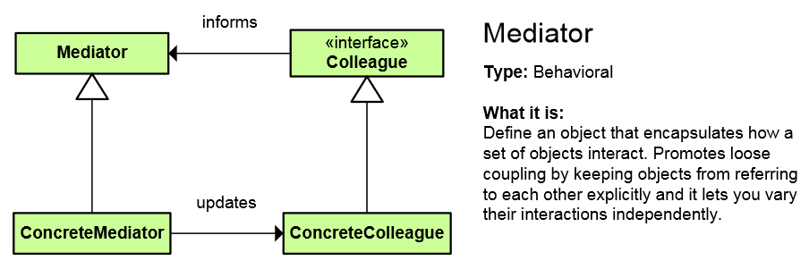
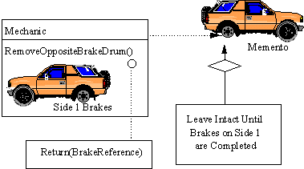
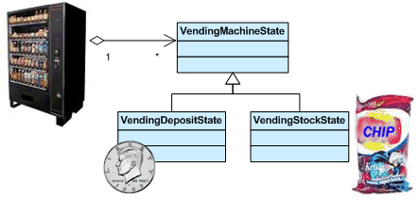
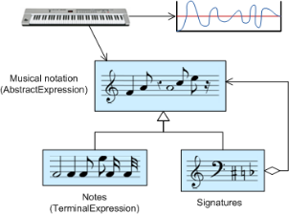
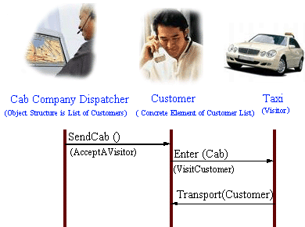
List of Behavioral Patterns (2)
Mediator
Memento
State
Interpreter
Visitor

Slide 37
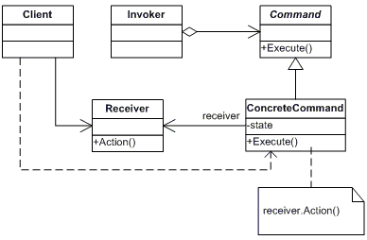
Command Pattern
An object encapsulates all the information needed to call a method at a later time
Lets you parameterize clients with different requests, queue or log requests, and support undoable operations

Slide 38
The Command Abstract Class
abstract class Command
{
protected Receiver receiver;
public Command(Receiver receiver) {
this.receiver = receiver; }
public abstract void Execute();
}
38

Slide 39
Concrete Command Class
class ConcreteCommand : Command
{
public ConcreteCommand(Receiver receiver)
: base(receiver) { }
public override void Execute()
=> receiver.Action();
}
39

Slide 40
The Receiver Class
class Receiver
{
public void Action()
{
Console.WriteLine("Called Receiver.Action()");
}
}
40

Slide 41
The Invoker Class
class Invoker
{
private Command _command;
public void SetCommand(Command command)
=> this._command = command;
public void ExecuteCommand()
=> _command.Execute();
}
41

Slide 42
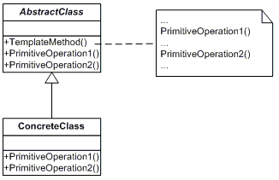
Template Method Pattern
Define the skeleton of an algorithm in a method, leaving some implementation to its subclasses
Allows the subclasses to redefine the implementation of some of the parts of the algorithm, but not its structure

Slide 43
The Abstract Class
abstract class AbstractClass
{
public abstract void PrimitiveOperation1();
public abstract void PrimitiveOperation2();
public void TemplateMethod() {
PrimitiveOperation1();
PrimitiveOperation2();
Console.WriteLine(""); }
}
43

Slide 44
A Concrete Class
class ConcreteClassA : AbstractClass
{
public override void PrimitiveOperation1()
=> Console.WriteLine("ConcreteClassA. PrimitiveOperation1()");
public override void PrimitiveOperation2()
=> Console.WriteLine("ConcreteClassA .PrimitiveOperation2()");
}
44

Slide 45

Summary
…
…
…
Design Patterns
Provide solution to common problems
Add additional layers of abstraction
Three main types of Design Patterns
Creational
Structural
Behavioral

Slide 46
Questions?
Notes:
46

Slide 47


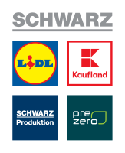










SoftUni Diamond Partners

Slide 48


Educational Partners

Slide 49
Trainings @ Software University (SoftUni)
Software University – High-Quality Education, Profession and Job for Software Developers
softuni.bg, about.softuni.bg
Software University Foundation
softuni.foundation
Software University @ Facebook
facebook.com/SoftwareUniversity
Software University Forums
forum.softuni.bg
49
Notes:
49

Slide 50

License
This course (slides, examples, demos, exercises, homework, documents, videos and other assets) is copyrighted content
Unauthorized copy, reproduction or use is illegal
© SoftUni – https://about.softuni.bg
© Software University – https://softuni.bg
Notes:
50

